Slide 1
DeepFakes: Masking and Unmasking Faces using Adversarial Network Abhishek Shivdeo Gaurav Bhosale Rahul Allam
1
Notes:
This PowerPoint Template includes a series of slide masters with predefined layouts and color schemes for formatting slides
Slide Masters are displayed when you right click on a slide and select Layout from menu

Slide 2
INTRODUCTION

Slide 3
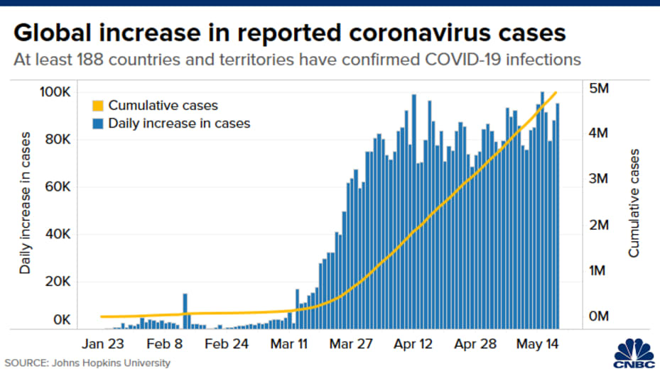
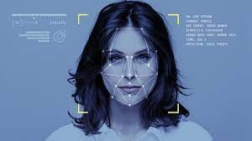

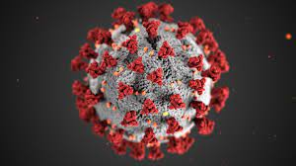
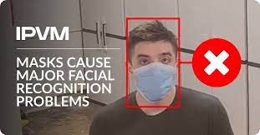
How it started?
Rise in the number of cases
Wearing mask
became mandatory
2020: The pandemic hits
Adverse effect on
facial recognition systems
Notes:
In 2020 when the pandemic hit us, the number of cases rose real quick, to mitigate the disastrous effect, wearing face masks became mandatory in almost every public place. As expected, it repercussions were observed in the facial recognition systems given that almost 50% of the facial features was covered with the mask.

Slide 4
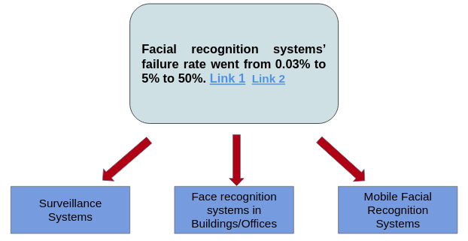
And why our research
Notes:
Using unmasked images, the most accurate algorithms fail to authenticate a person about 0.3% of the time. Masked images raised even these top algorithms’ failure rate to about 5%, while many otherwise competent algorithms failed between 20% to 50% of the time. Reports

Slide 5
Recognizing the problem
Recognizing the masks:
Masked Face Recognition using ResNet-50. Paper
SSDMNV2: A real time DNN-based face mask detection system using single shot multibox detector and MobileNetV2. Paper
Real-Time Implementation of AI-Based Face Mask Detection and Social Distancing Measuring System for COVID-19 Prevention. Paper
An Automated System to Limit COVID-19 Using Facial Mask Detection in Smart City Network. Paper
Application of deep learning and machine learning models to detect COVID-19 face masks - A review. Paper
Masked face recognition with convolutional neural networks and local binary patterns. Hoai Nam Vu et al.
Notes:
Now comes the question what do we do about it? When it comes to recognizing the problem, significant work has been done to detect a personwearing a mask. Although, a simple google search would give you 100s of papers and artciles and codes to detect a mask, there hasn’t been much work font to solve the problem

Slide 6
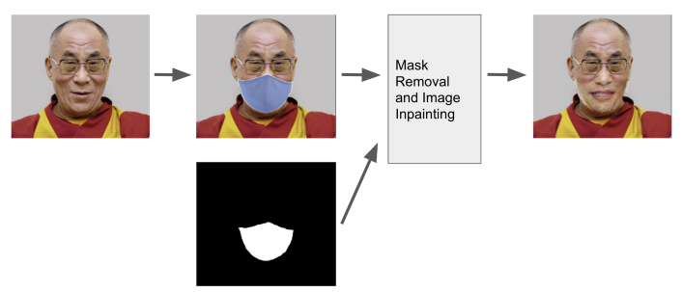
Doing something about the problem
Developing methods to unmask:
Facial Recognition for People Wearing Masks. Paper, Zhen Li et al.
Notes:
Here they extract local binary pattern features from masked face’s eye, forehead and eyebrow areas and combine them with features learnt from RetinaFace into a unified framework for recognizing masked faces
This was a supervised face detector that achieved an f1-score of 87% on a data-set of 300 masked subjects. But even these methods fail to achieve higher accuracy. This is due to the fact that there aren’t many high-quality, large enough data-sets of paired images with masked and unmasked faces. This data-set of pairs of images can be used to train deep learning models which can unmask the masked faces to predict the original faces without the mask

Slide 7
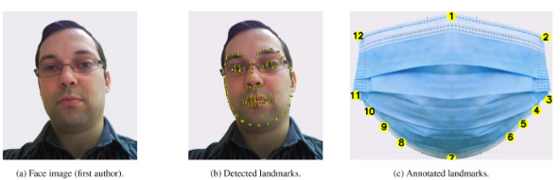
Doing something about the problem
Generating datasets:
MaskedFace-Net – A dataset of correctly/incorrectly masked face images in the context of COVID-19. Paper, AdnaneCabani et al.
Notes:
Some work was also done to generrate such datasets. In his paper, maskedfacenet, tried making such a dataset of pairs of masked and unamksed iamges using image procssing.

Slide 8
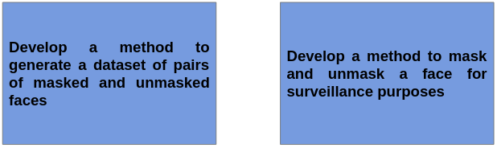
Goals
Tackle the shortage
of dataset
Tackle problem of failure of
facial recognition systems

Slide 9
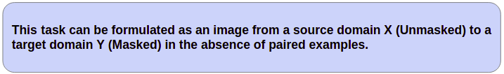
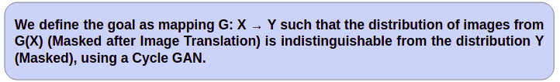
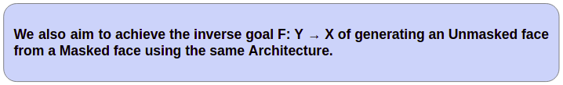
Problem Formulation

Slide 10
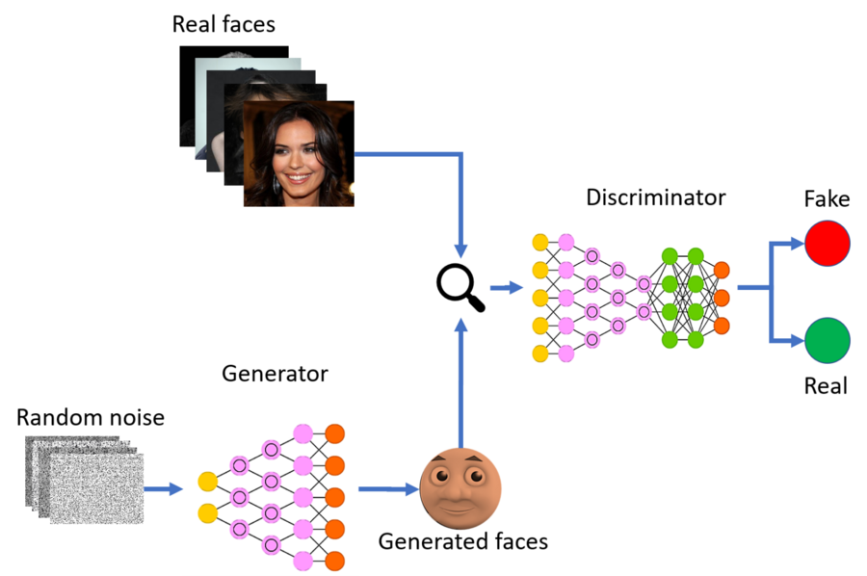
GAN
Notes:
Generative Adversarial Networks (GAN) is an unsupervised learning task in machine learning that involves automatically discovering and learning the patterns in input data in such a way that the model can be used to generate new examples that plausibly could have been drawn from the original dataset.
A generative adversarial network (GAN) is a machine learning (ML) model in which two neural networks compete with each other to become more accurate in their predictions. GANs typically run unsupervised and use a cooperative zero-sum game framework to learn.
The two neural networks that make up a GAN are referred to as the generator and the discriminator. The generator is a convolutional neural network and the discriminator is a deconvolutional neural network. The goal of the generator is to artificially manufacture outputs that could easily be mistaken for real data. The goal of the discriminator is to identify which outputs it receives have been artificially created.

Slide 11
METHODOLOGY

Slide 12
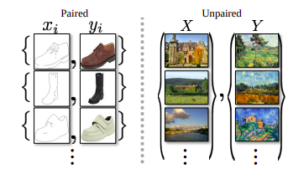
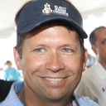
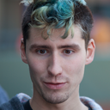

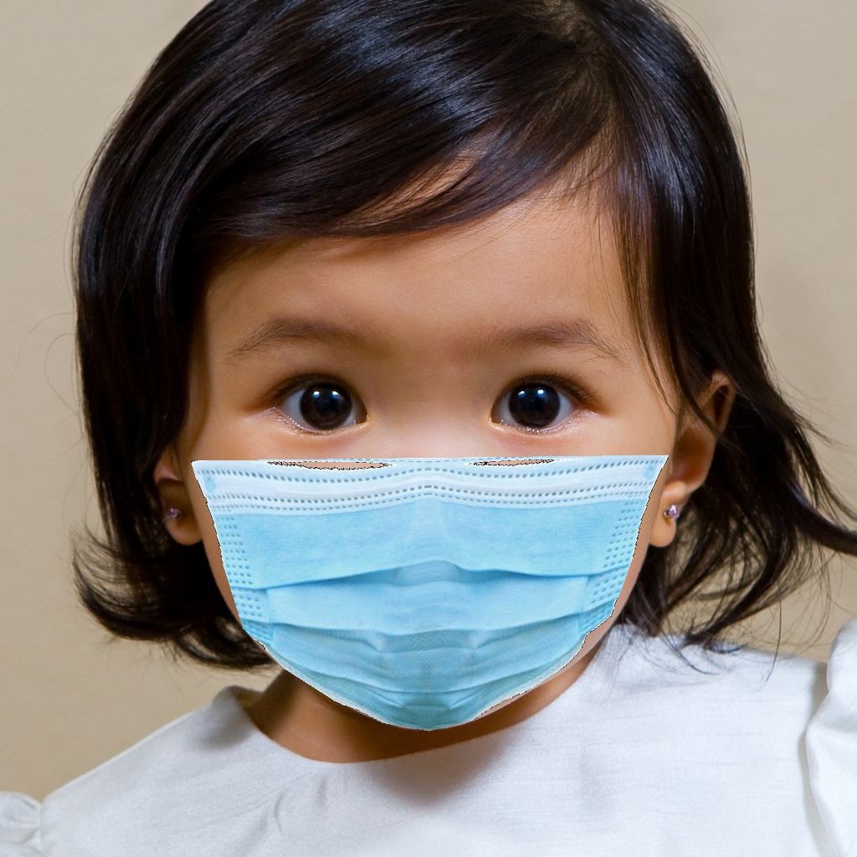
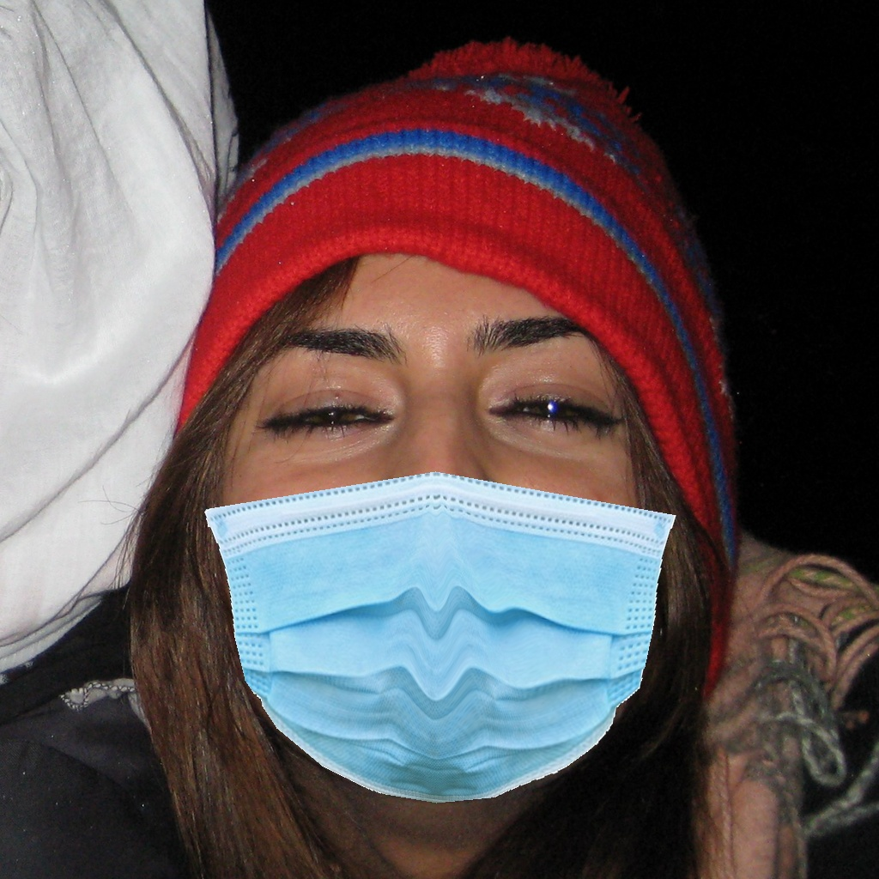
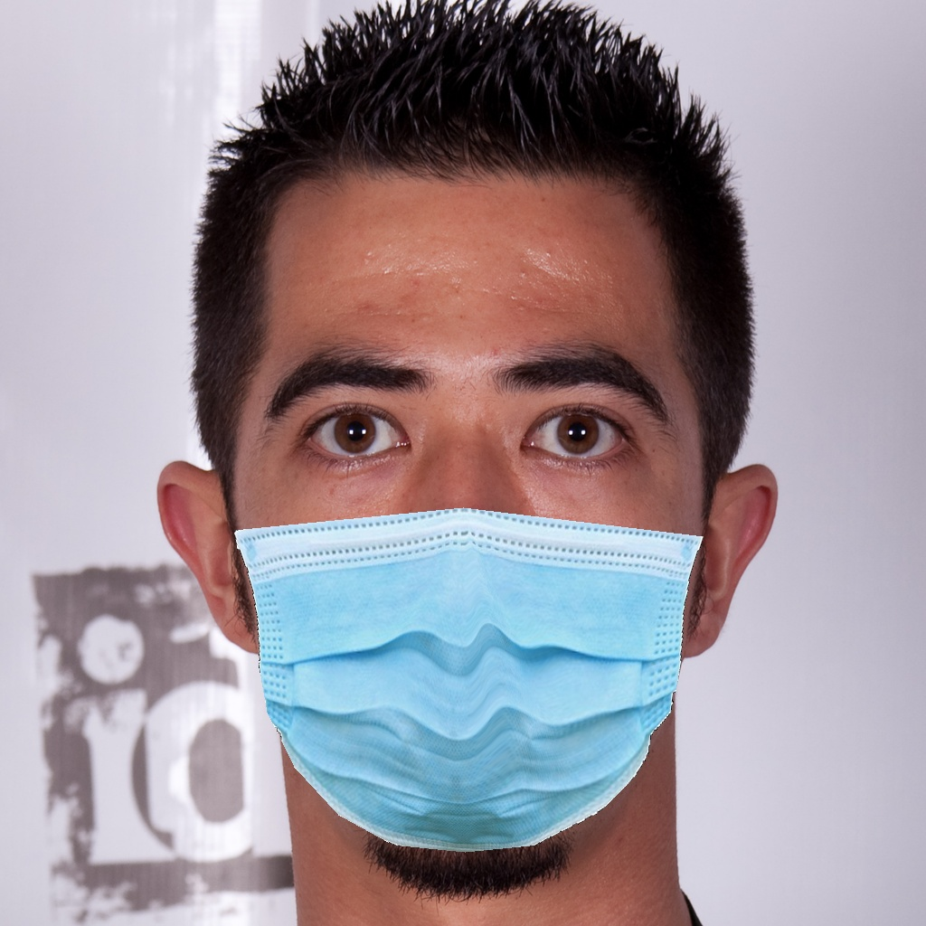
Dataset
Flickr-Faces-HQ (FFHQ) data-set for unmasked images ​
MaskedFace-Net data-set for masked images.​
We curate the images based on mask-placement , visibility of mask etc.​
We use a subset of 6000 masked images and 6000 unmasked images for training.​
1000 test images from each of them were used for testing.​
Notes:
The paired training data consists of examples x_i where for each y_i, a corresponding $y_i$ exists. Our data-set on the other hand resembles the right hand side in Figure 1, with no information on matches between pairs or no pairs available. In a variety of cases, it is difficult to obtain such a data-set or too expensive. Such is our case of masked and unmasked faces where no data-set is available for paired data-sets.
Paired datasets usually use superivised methods where as methods use unsupervised methods.
For unmasked faces, FFHQ is a high-quality image data-set of human faces, originally created as a benchmark for generative adversarial networks (GAN). The data-set consists of 70,000 high-quality PNG images at 1024×1024 resolution with variation and diversity in terms of subjects and objects in the frame. It also has good coverage of accessories such as eyeglasses, sunglasses, hats, etc.
For our masked face data-set, we use the MaskedFace-Net dataset, which is a dataset of human faces with a correctly or incorrectly worn mask (133,783 images) based on the Flickr-Faces-HQ (FFHQ) data-set. The masks are photo-shopped onto the faces.
Although the dataset is based on FFHQ, the facemasks are incorrectly masked for most of the images. For both of these data-sets, we curate images based on the number of faces in images, mask placement, mask clarity, and realistic effect of the mask on the image. We use a subset of 6000 masked images and 6000 unmasked images for training and 1000 test images from each of them were used for testing.\\

Slide 13
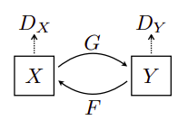
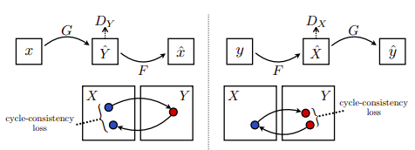
CycleGAN
CycleGAN is a technique for training unsupervised image translation models via the GAN architecture using unpaired collections of images from two different domains. [paper]
The model contains:
Two Generators – G and F
Two Discriminators – Dx and Dy
Where X and Y correspond to unmasked and masked image domain respectively
Highly under-constrained Problem.
Cycle consistency idea is introduced to translate images from source domain to destinations domain and back.
Forward cycle-consistency loss
Backward cycle-consistency loss
Architecture:
Generator has three sections:
Encoder , 3 convolutional layers
Transformer , 6 residual blocks
Decoder, two Transpose convolution
Discriminator is fully convolutional
network working on patches of images.
Notes:
The CycleGAN approach has been used to add masks to our images. CycleGAN consists of two generators and two discriminators. Lets assume our domain X is unmasked images and domain Y is masked images. One of the generator (Generator G) translates images from domain X to domain Y. The second generator (Generator F) translates images from domain Y to domain X. Thus, we have two mapping functions G : X → Y and F : Y → X.
Each of these generators have an associated adversarial discriminator. We define them as $D_y$ and $D_x$. The discriminator $D_y$ encourages our Generator G to translate images from domain X into the outputs indistinguishable from domain $Y$ and vice versa.
The discriminators are PatchGANs, fully convolutional neural networks that look at a “patch” of the input image, and output the probability of the patch being “real”. This is both more computationally efficient than trying to look at the entire input image, and is also more effective — it allows the discriminator to focus on more surface-level features, like texture, which is often the sort of thing being changed in an image translation task.
The training procedure involved rigorous experimentation with hyperparameters such as learning policy (Linear, Cosine), GAN loss (Vanilla, Lsgan), normalization techniques (Instance, Batch), and batch size (16, 32). Each model was trained for 200 epochs each. Post the training phase, we made predictions on the test data-set. The computed FID scores for both cases, i.e., translation from the unmasked domain (A) to masked domain (B) $FID_{AB}$, and from the masked domain (B) to the unmasked domain (A) $FID_{BA}$, using different hyper-parameters can be seen in Table I.
Trained on 4 nvidia tesla v100 with each requiring 12 hours

Slide 14
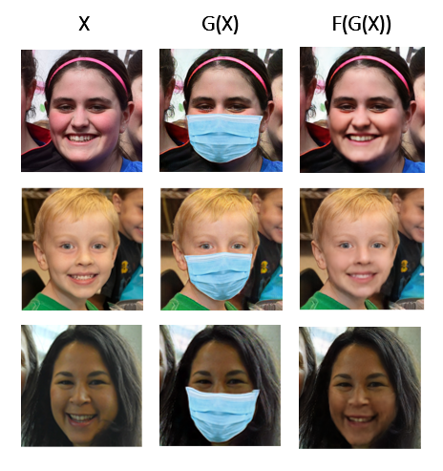
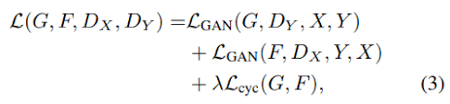
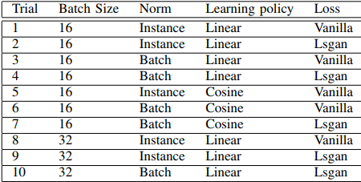
CycleGAN Training
We optimize over this total loss.​
Architecture
Generator has three sections:
Encoder - 3 convolutional layers
Transformer - 6 residual blocks
Decoder - 2 Transpose convolution
Discriminator is fully convolutional
network working on patches of images.
Notes:
Each CycleGAN generator has three sections: an encoder, a transformer, and a decoder. The input image is fed directly into the encoder, which shrinks the representation size while increasing the number of channels. The encoder is composed of three convolution layers. The resulting activation is then passed to the transformer, a series of six residual blocks. It is then expanded again by the decoder, which uses two transpose convolutions to enlarge the representation size, and one output layer to produce the final image in RGB.
The discriminators are PatchGANs, fully convolutional neural networks that look at a “patch” of the input image, and output the probability of the patch being “real”. This is both more computationally efficient than trying to look at the entire input image, and is also more effective — it allows the discriminator to focus on more surface-level features, like texture, which is often the sort of thing being changed in an image translation task.
The training procedure involved rigorous experimentation with hyperparameters such as learning policy (Linear, Cosine), GAN loss (Vanilla, Lsgan), normalization techniques (Instance, Batch), and batch size (16, 32). Each model was trained for 200 epochs each. Post the training phase, we made predictions on the test data-set. The computed FID scores for both cases, i.e., translation from the unmasked domain (A) to masked domain (B) $FID_{AB}$, and from the masked domain (B) to the unmasked domain (A) $FID_{BA}$, using different hyper-parameters can be seen in Table I.
Trained on 4 nvidia tesla v100 with each requiring 12 hours

Slide 15
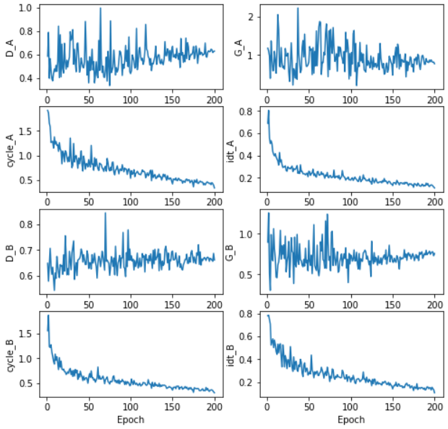
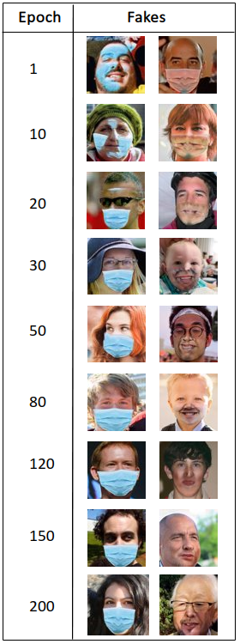
CycleGAN Training
Notes:
Finally, we plot the variation of losses over 200 epochs training. From figure 10, we can see generator losses $G_A$, $G_B$ and discriminator losses $D_A$, $D_B$ keep oscillating without ever consistently increasing or decreasing with time. This is because cycleGAN uses min max optimization\cite{DBLP:journals/corr/ZhuPIE17}. But with training over multiple epochs, we see a decrease in oscillations. In general, discriminator and generator losses trend is ignored because our generator is only as good as our discriminator and vice versa. For instance, if mediocre generator can fool a bad discriminator into believing the generator images are real even if they are not. Hence, we track cycle consistency losses and their trend with number of training epochs. We see the cycle loss decrease with every additional epoch of training. This decrease implies that the generator models are tending towards a desirable state, where we can achieve the ideal translation

Slide 16
Evaluation
No agreed upon metric for GANs.
​Qualitative Metric :
Amazon Mechanical Turks(AMT)
We created a google form which shows sequence of images asking to label real or fake.
Consisting of 22 images
Approximate 2200 datapoints with 100+ responses
Quantitative Metric:
Frechet Inception Distance (FID) score.
Improvement over Inception Score.
Compares the Distribution of Fake and Real Images.
Lower FID score implies the images are highly correlated i.e. belong to the same domain
Notes:
FID performs well in terms of discriminability, robustness and computational efficiency.
It has been shown that FID is consistent with human judgments and is more robust to noise than IS.
A lower FID score implies the images are highly correlated i.e belong to the same domain.
The underlying network of FID captures vision-specific features of an input image. The distance between these distributions is determined using the Frechet distance.
A lower FID score implies the distribution of the generated fakes matches the distribution of ground truth real images.

Slide 17
RESULTS

Slide 18
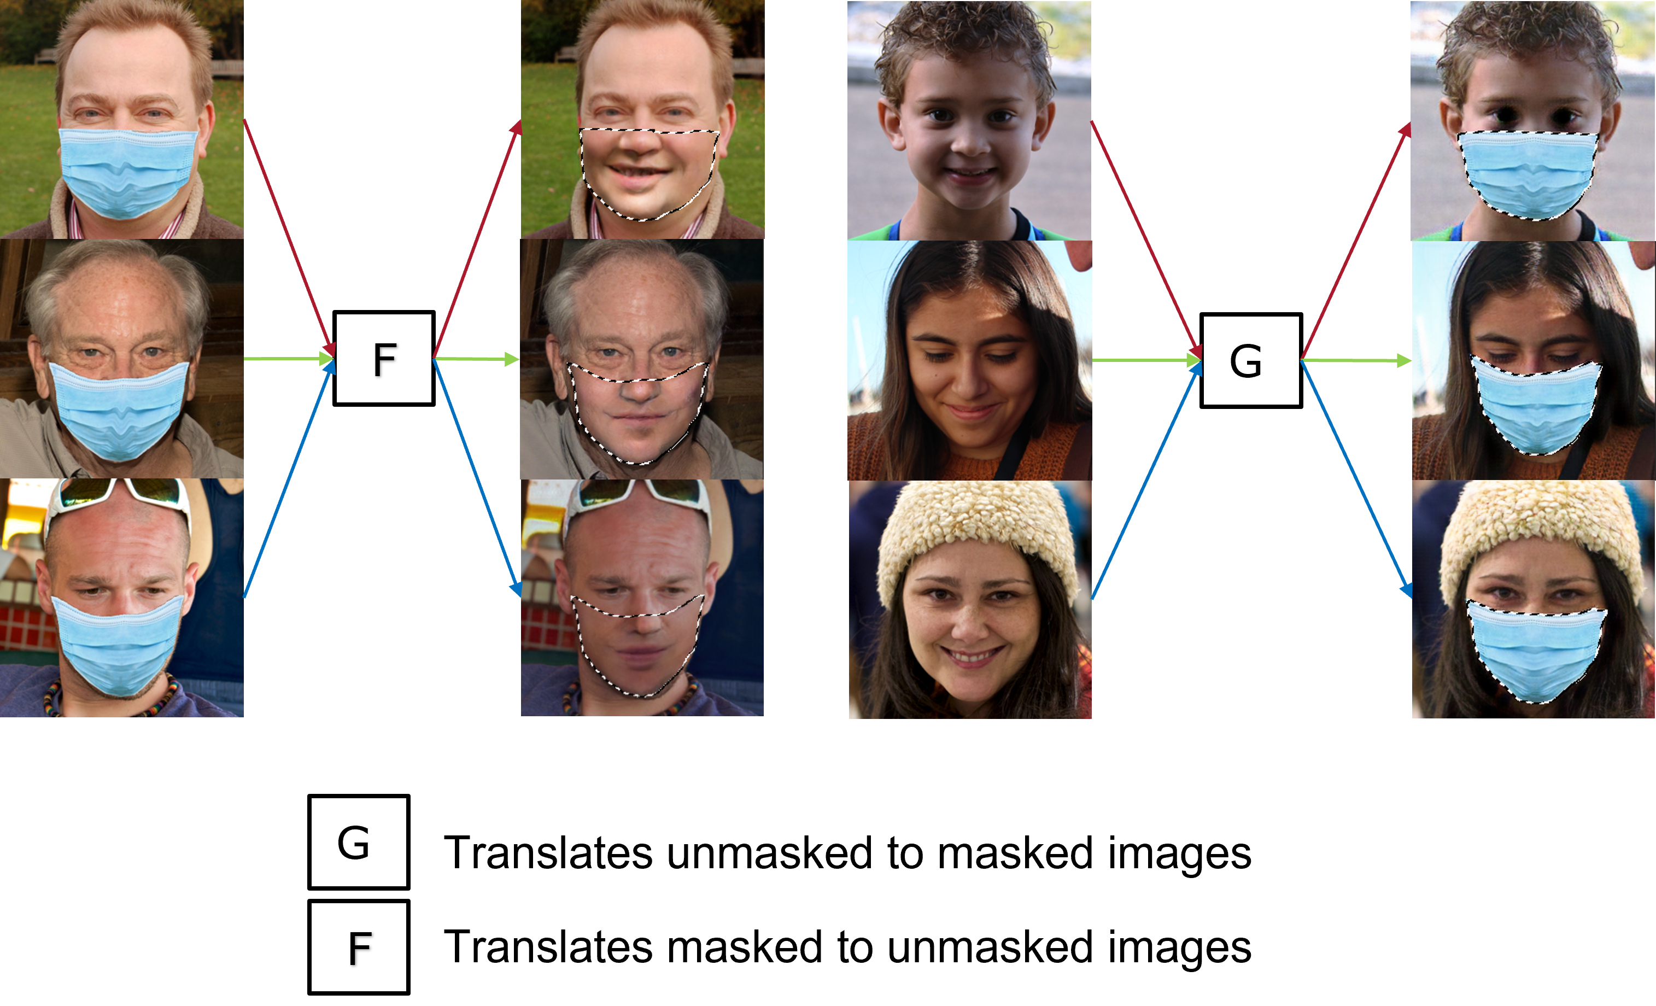
Real images vs generated fakes

Slide 19
Evaluation
GAN’s lack a common metric function, which makes it difficult to compare performance of different models. This means that there is no generally agreed upon way of evaluating a given GAN generator model.
While several measures have been introduced, as of now, there is no consensus as to which measure best captures strengths and limitations of models and should be used for fair model comparison.
Hence, we use a combination of GAN evaluation methodologies to evaluate the performance of our generator models
Evaluation methodologies
Manual GAN generator evaluation
Qualitative GAN generator evaluation
Quantitative GAN generator evaluation

Slide 20
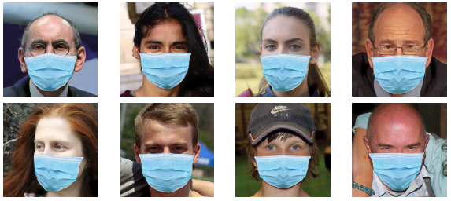
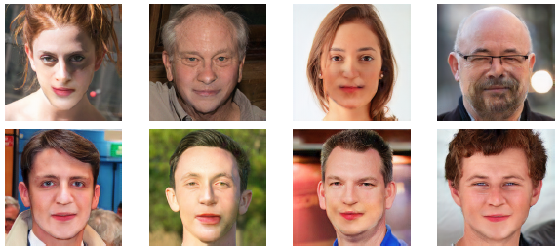
Manual GAN generator evaluation
Visual examination of samples by humans is one of the common and most intuitive ways to evaluate GANs.
Pros
Simple
Cons
Evaluating the quality of generated images with human vision is subjective, expensive, cumbersome, difficult to reproduce, and does not fully reflect the capacity of models.
Deep Fakes generated by the best Generator model G
Deep Fakes generated by the best Generator model F

Slide 21
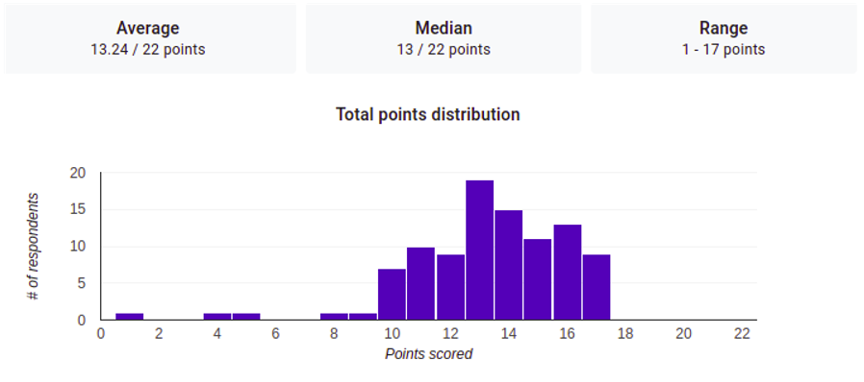
Qualitative GAN generator evaluation
Qualitative measures involve evaluation via comparison.
Rating and Preference Judgment is the most used qualitative method: Images are often presented in pairs and the human judge is asked which image they prefer, e.g., which image is more realistic.
Cons
Performance of human judges is not fixed and can improve over time.
Survey statistics
# of images in survey | 22
# of responses | 100
# of predictions | 2200
# of wrong predictions | 881
Probability of duping a human | 40.08%
Statistical data resulting from our “Rating and Preference Judgment” survey titled “Real or Fake?”
Notes:
In the qualitative metric, the user was asked to guess and filter out the ground truth from the GAN-generated outputs out of 22 images that were randomly presented to the user. Each correct answer fetches the user 1 point. As it stands, we received 100 responses and the following is the analysis: Of the 2200 predictions, the users wrongly guessed 881 times. This gives us an accuracy of 40.08\% which implies, the generated fakes were able to dupe the user 40.08\% of time, which is impressive, considering the discerning sight we humans possess, thus validating our model through visual inspection. The statistics for the survey can be seen in Fig. 12, where the average score of the user is 13.24.
This is especially the case if they are given feedback, such as clues on how to detect generated images. By learning from such feedback, annotators are better able to point out the flaws in generated images, giving a more pessimistic quality assessment.

Slide 22
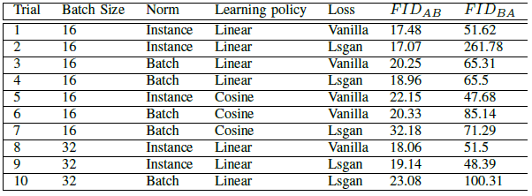
Quantitative GAN generator evaluation
We evaluated our generator models based on Fréchet inception distance (FID), a quantitative GAN evaluation metric.
FID scores FID_{AB} and FID_{BA} of generator models G_{AB} and G_{BA} with change in hyper-parameters
Notes:
FID performs well in terms of discriminability, robustness and computational efficiency. It has been shown that FID is consistent with human judgments and is more robust to noise than IS.
A lower FID score implies the images are highly correlated i.e belong to the same domain. The underlying network of FID captures vision-specific features of an input image. These activations are computed for a set of real and fake generated images and are interpreted as a multivariate Gaussian distribution. The distance between these distributions is determined using the Frechet distance. A lower FID score implies the distribution of the generated fakes matches the distribution of ground truth real images.
Interpretations:
Best G_AB for batch size 16, instance normalization, linear learning policy and lsgan optimization loss. We also observe that the $FID_{AB}$ score ranges between 17.07 and 32.18. The best score of 17.07, coupled with small range means that the generator network $G_{AB}$ is finding it relatively easier to learn how to apply a fake mask onto an unmasked face, Similarly, we achieved the least $FID_{BA}$ of 48.39 with a generator model $G_{BA}$, which was trained with batch size 32, instance normalization, linear learning policy and vanilla optimization loss. The best score of 48.39 implies the generator network $G_{BA}$ is finding it slightly difficult to generate the masked area of the face. We also observe that $FID_{BA}$ score ranges between values 48.39 and 261.78, which implies the performance of the network varies significantly with change in hyper parameters.

Slide 23
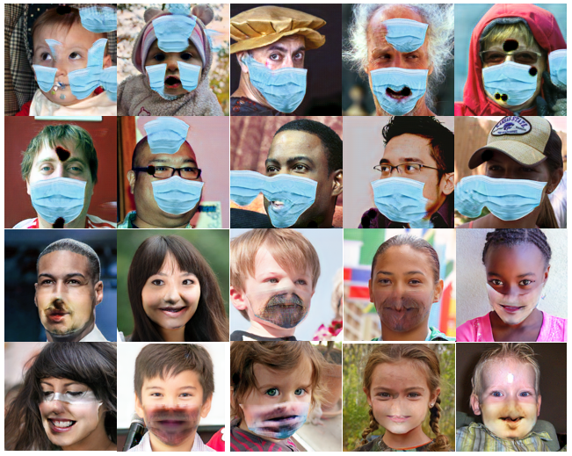
Some of the bad fakes generated by our prior models
One might have to ask,
Brace yourselves!
Are they even human?!

Slide 24
CONCLUSION

Slide 25
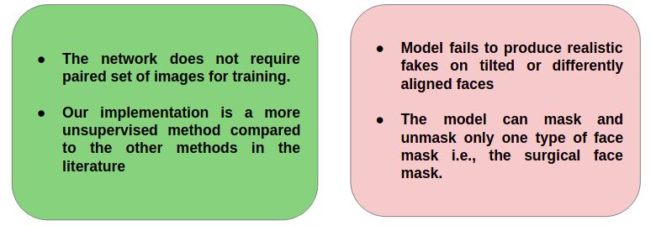
Deductions

Slide 26
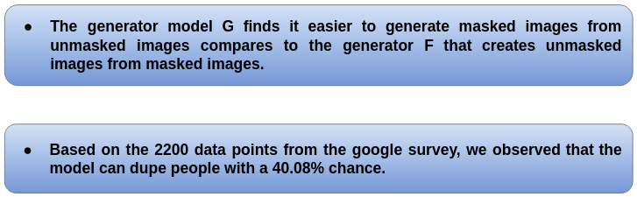
Interpretation of results

Slide 27
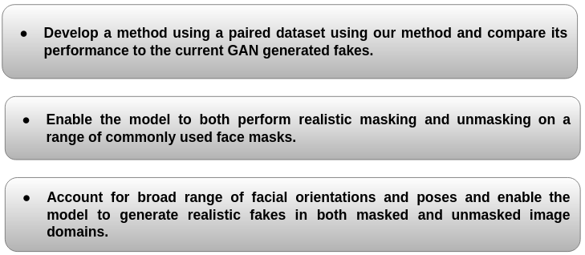
Future scope

Slide 28
Miscellanous
Github: https://github.com/Allamrahul/AI_project_deep_fakes
Generated fakes
https://drive.google.com/drive/u/1/folders/1NKO_JHUIiBKLY8hUJqNUE8aQK7gXpDpS
https://drive.google.com/drive/u/1/folders/1k3zdGciqTCYtgRLC3SEMEdWYb8VNA3J-

Slide 29
